Slide 1

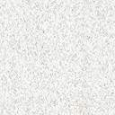
The Digital Sommelier
Using Statistical Modelling/Machine Learning to predict wine quality based on its chemical constituents.
Compiled By: Warren Villarosa
7-minute presentation
This Photo by Unknown Author is licensed under CC BY

Slide 2
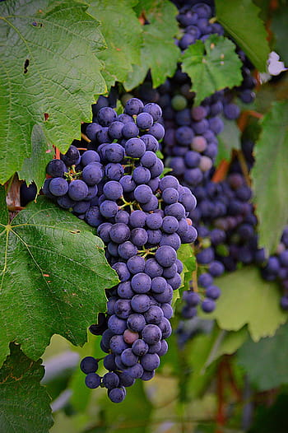
Growing the Grapes (Hypothesis, Questions and Data Selection)
“Making good wine is a skill, making fine wine is an art”
-Robert Mondavi
Hypothesis:
The chemical constituents of a wine can be used to effectively predict its perceived quality.
The burning and critically important questions that I set out to answer in this project were:
Is wine better if it can get me hammered quicker, (does a higher alcohol content make the wine better)?
Why do only old people like port (does a wine’s thickness affect its quality)?
I want to impress this attractive person with my refined taste in wine, is there an app for that?
To help me do this I used the following CSV dataset from Kaggle.com
P. Cortez, A. Cerdeira, F. Almeida, T. Matos and J. Reis. Modeling wine preferences by data mining from physicochemical properties. In Decision Support Systems, Elsevier, 47(4):547-553, 2009.

Slide 3
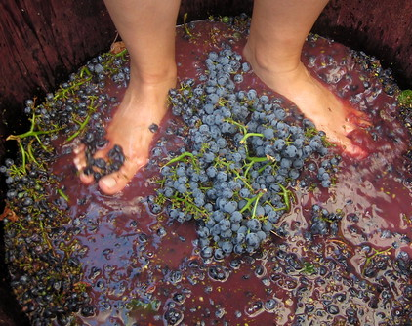
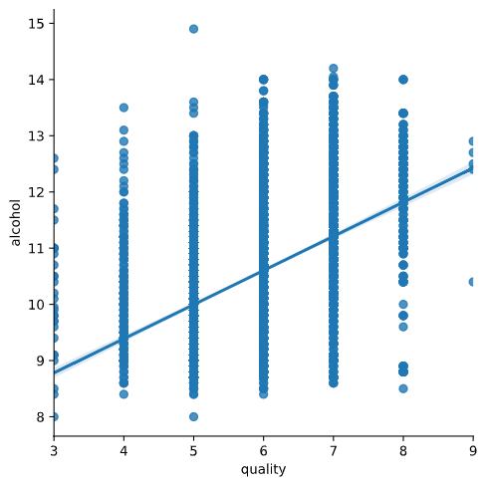
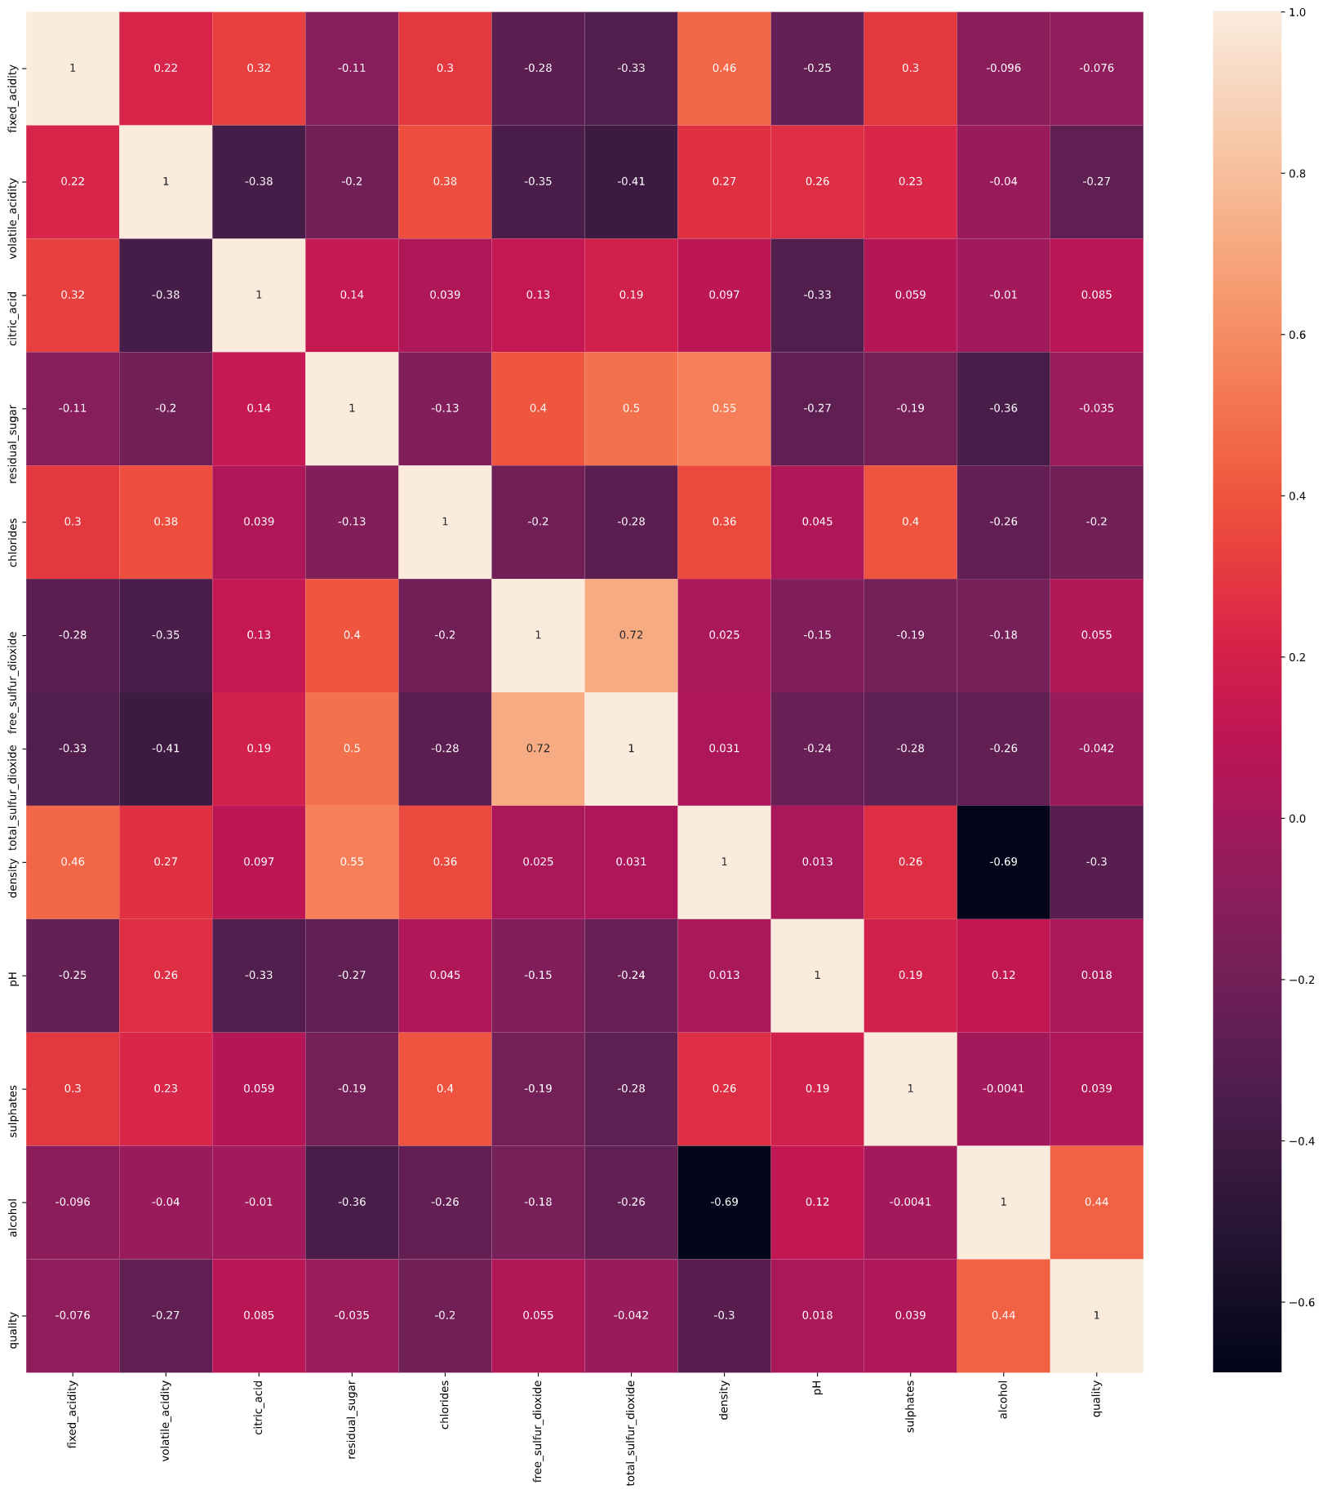
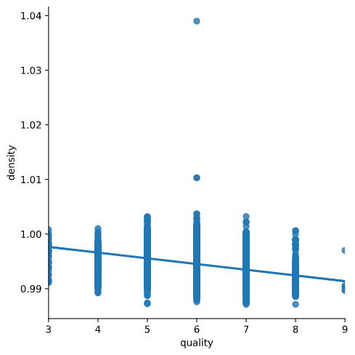
Crushing the Grapes (Determining Class, Features and Selecting Models)
Based on the original hypothesis, the class I wanted to determine was quality. I did a bit of EA and used a correlation matrix to then determine the features I wanted. Alcohol content was a must but in order to balance out its strong correlation, I needed to include more negative features with weaker correlations. Duplicate and a few very weak correlations were dropped. (Fixed Acidity, Citric acid, Free SO2 and Total SO2 levels).
Is wine better if it can get me hammered quicker?
It appears so, based on the strong correlation
Why do only old people like port?
We still don’t know, but the general preference seems to be that the wine be less dense.
Model Selection: Quality could be split into high and low. Therefore, it could be simplified into a Boolean. Logistic Regression fits an s-shaped logistic function to the data that starts at 0 and ends at 1, it also works with continuous or discrete data. If I made 0 Low Quality and 1 High quality, I could use logistic regression to classify my wines into those categories.
Since it’s a classification problem, random forest could also be used. Because of some of the stronger correlations, there was a concern with overfitting. By adding extra trees and bootstrapping, I felt that the Random Forest classifier might be able to alleviate that and provide more accuracy. Random forest creates using random features to create new trees with different nodes. By bootstrapping I can add in extra randomization to help with my overfitting issue.
This Photo by Unknown Author is licensed under CC BY-NC-ND

Slide 4
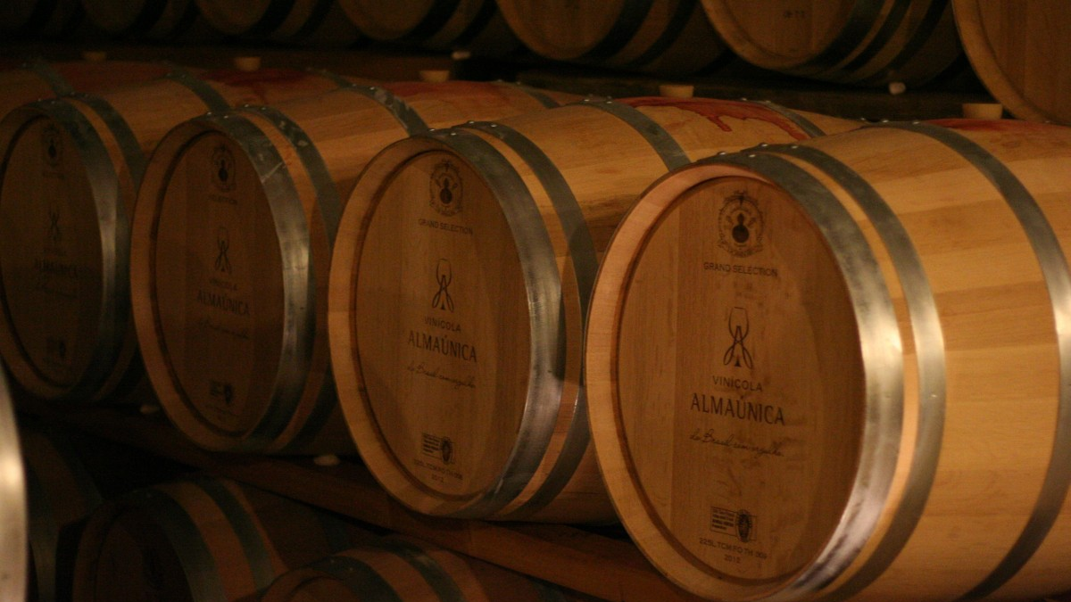
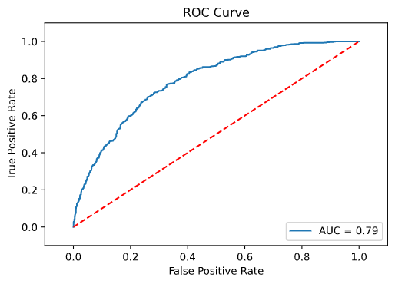
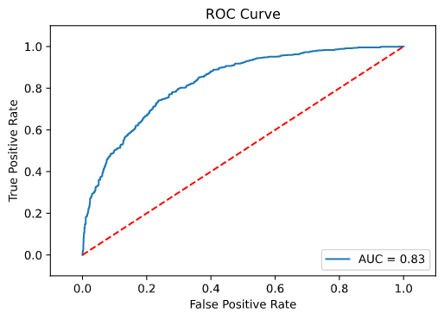
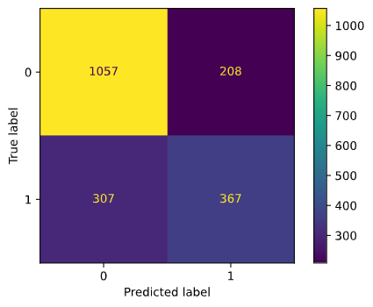
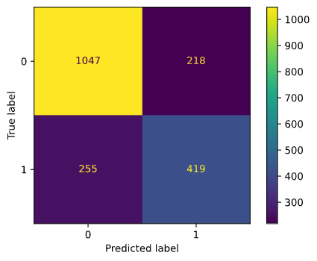
Fermenting the wine (Testing the Models, Prepping for Deployment)
Logistic Regression
Random Forest
The two models are comparable when it comes to true positives.
There is more separation between the true negatives and the false negatives in the random forest model.
Because this is a binary classifier, Receiver Operating Characteristic curves are suitable to illustrate the effectiveness of the models. Based on the ROC curves the Random Forest performs slightly better with and area under curve of 0.83.
Based on the performance, vs computing power and time required, the Logistic Regression may be the better of the two choices.
Cross Validation Score: 73.78%
Training Set Accuracy: 73.85%
Test Set Accuracy: 73.44%
Cross Validation Score: 77.45%
Training Set Accuracy: 81.52%
Test Set Accuracy: 75.61%
Modelling Outcomes

Slide 5
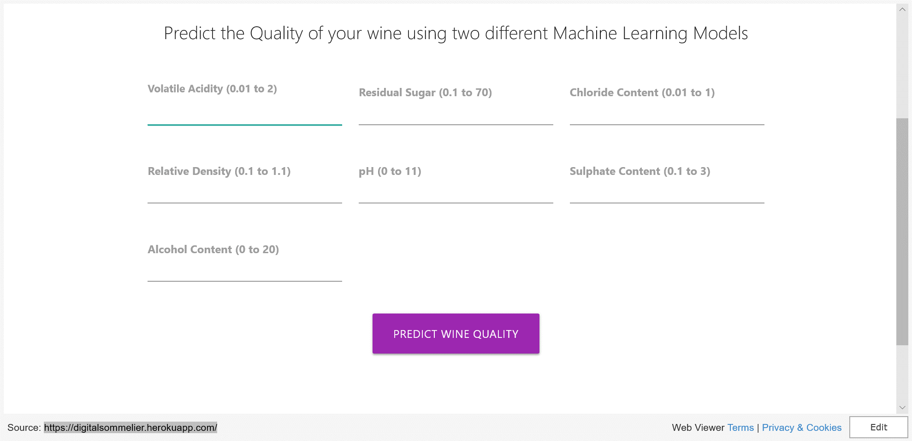
Drinking that sweet, sweet, nectar (Deployment)
I want to impress this attractive person with my refined taste in wine, is there an app for that?
There is now. Introducing: Digital Sommelier.

